Slide 1
Unit 3
Performance and Regression Testing
By: Anand C Unakal

Slide 2

Introduction to Performance Testing
Performance testing is the process of determining the speed or effectiveness of a computer, network, software program or device.

Slide 3
FACTORS GOVERNING PERFORMANCE TESTING
Throughput:
Response Time:
Latency:
Tuning:
Benchmarking:
Capacity planning:

Slide 4
Methodology for Performance Testing
Performance testing is complex and expensive due to large resource requirements and the time it takes. Hence, it requires careful planning and a robust methodology.
A methodology for performance testing involves the following steps:
Collecting Requirements
Writing test cases
Automating Performance test cases
Executing performance test cases
Analyzing performance test results
Performance tuning
Performance benchmarking
Recommending right configuration for the customers

Slide 5
Collecting Requirements:
It is the first step in planning the performance testing. It include the finite set of inputs and outputs, expected results, elaborate documentation, environment set up, etc.
The requirements collected should satisfy the following criteria’s:-
Requirements should be testable.
Requirements should be clearly stated.
Percentage of improvement that is desired should be stated.

Slide 6
Writing Test Cases
The next step involved in performance testing is writing test cases. A test case should have :
List of operation or business transactions to be tested.
Steps to executing those operations/transactions.
List of products, OS parameters that impact the performance testing and their values.
Loading pattern.
Resource and their configuration
The expected results
The product versions/competitive products and related information in corresponding field.

Slide 7
Automating performance test cases
End to end automation is required for performance testing. All the test cases designed require automation due to the following conditions:
Performance testing is repetitive.
Performance test cases cannot be effective without automation.
The results of performance testing need to be accurate.

Slide 8
Executing performance test cases
Performance testing generally involves more effort in planning, data collection and analysis but less effort in execution.
Data collection in execution refers to:
Start and end time of test case execution.
Log and trace/audit files of the product and operating system for future debugging.
Utilization of resources.
Configuration of environmental factors.
All factors for performance testing like response time, throughput, latency, etc.

Slide 9
Analyzing the performance test results
Analyzing the performance test results require multi-dimensional thinking. This is the most complex part of performance testing where product knowledge, analytical thinking and statistical background are all absolutely essential.
The analysis of performance data is carried out to conclude the following:
Whether performance of the product is consistent when tests are executed multiple times.
What performance can be expected for what type of configuration resources?

Slide 10
Performance tuning
Performance tuning is an exercise that needs high degree of skill in identifying the list of parameters and their contribution to performance.
Performance benchmarking
Performance benchmarking is about comparing the performance of product transactions with that of the compotator.
No two products can have the same architecture, design, functionality and code therefore End user transactions/scenarios should be considered for comparison .

Slide 11
Capacity planning
Capacity planning necessitates a clear understanding of the resource requirements for transactions/ scenarios. This understanding of what resources are needed for each transactions is a prerequisite for capacity planning.

Slide 12
Tools for Performance Testing
There are 2 types of tools that can be used for performance testing – functional performance tools and load tools
Some popular performance tools are listed below:
Functional Performance tools
WinRunner from Mercury
QA Partner from Compuware
Silktest from segue
Load testing tools
Load Runner from Mercury
QA Load from Compuware
Silk Performer from segue

Slide 13
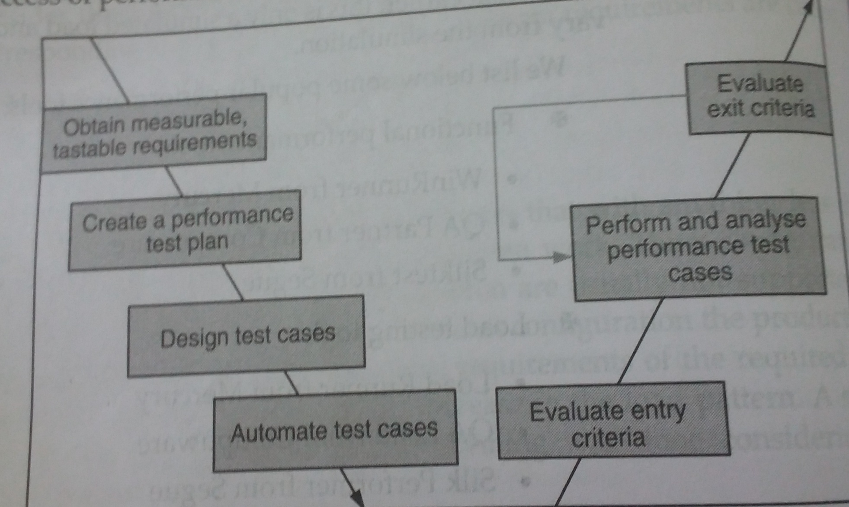
Process for performance testing

Slide 14
Making the requirements testable and measurable is the first activity needed for the success of performance testing.
The next step in performance testing process is to create a performance test plan. This test plan needs to have the following details.
Resource requirements
Test bed (simulated and real life), test-lab setup
Responsibilities
Setting up product traces, audits and traces(external and internal)
Entry and exit criteria

Slide 15
CHALLENGES FACED BY PERFORMANCE TESTING
Performance testing is not very well understood topic in the testing community. The are several interpretations of performance testing.
The availability of skills is a major problem facing performance testing.
Performance testing requires a large number and amount of resources such as hardware, software, effort, time, tools and people.

Slide 16
CHALLENGES FACED BY PERFORMANCE TESTING
Performance test results need to reflect real life environment and expectations.
Selecting the right tool for the performance testing is another challenge.
Interfacing with different teams that include a set of customers.
Lack of seriousness on performance tests by the management and development team.

Slide 17
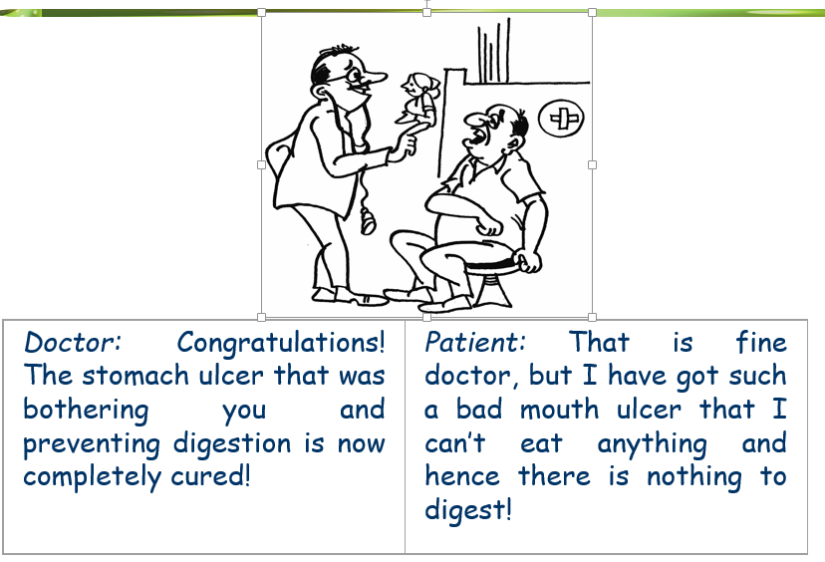
Regression Testing

Slide 18
Regression Testing
Software undergoes constant changes. Such changes are necessitated because of defects to be fixed, enhancements to be made to existing functionality, or new functionality to be added.
Anytime such changes are made, it is important to ensure that:
The changes or additions work as designed; and
The changes or additions do not break something that is already working and should continue to work.
Regression testing is designed to address the above 2purposes.

Slide 19
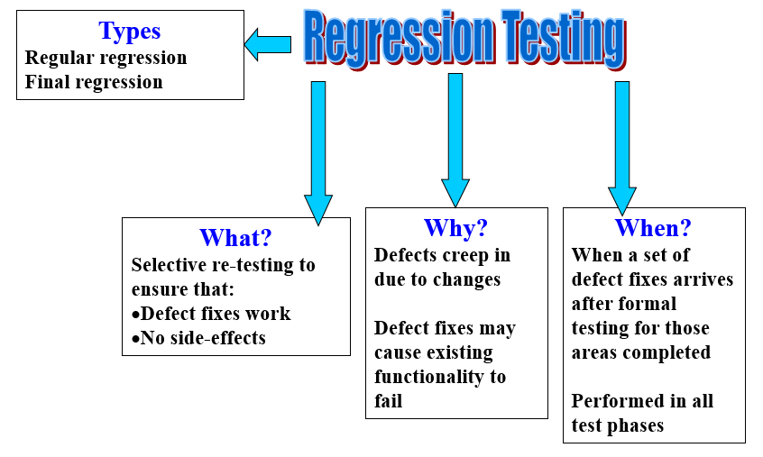
Regression Testing

Slide 20
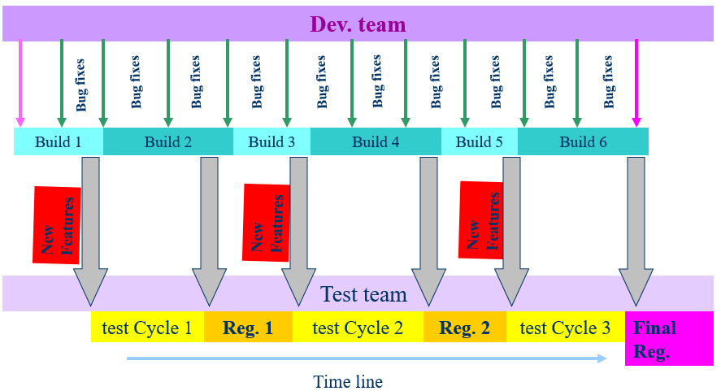
Types of regression testing

Slide 21
Types of regression testing
There are 2 types of regression testing
Regular regression testing
Final regression testing
Regular regression testing is done between test cycles to ensure that the defect fixes that are done and the functionality that were working with the earlier test cycles continue to work.
Regular regression testing can use more than one product build for the test cases to be executed

Slide 22
A final regression testing is done to validate the final build before release. The Configuration Management engineer delivers the final build with the media and other contents exactly as it would go to the customer.
The final regression test cycle is conducted for a specific period of duration, which is mutually agreed upon between the development and testing teams. This is called the “cook time” for regression testing

Slide 23
When to do Regression Testing
It is necessary to perform regression testing when
A reasonable amount of initial testing is already carried out.
A good number of defects have been fixed.
Defect fixes that can produce side-effects are taken care of.

Slide 24
How to do Regression Testing
A several methodologies for Regression Testing that are used by different organizations;
Performing an initial “Smoke” or “Sanity” test
Understanding the test criteria for selecting the test cases
Classifying the test cases into different priorities
A methodology for selecting test cases
Resetting the test cases for test execution
Concluding the results of a regression cycle

Slide 25
Performing an initial “Smoke” or “Sanity” test
Whenever changes are made to a product, it should first be made that nothing basic breaks.
Smoke testing consists of:
Identifying the functionality that a product must satisfy ;
Designing test cases to ensure that these basic functionality work and packaging them into a smoke test suite;
Ensuring that every time a product is built, this suite is run successfully before anything else is run; and
If this suit fails, escalating to the developers to identify the changes and perhaps change or roll back the changes to a state where the smoke test suite succeeds.

Slide 26
Understanding the test criteria for selecting the test cases
Having performed a smoke test, the product can be assumed worthy of being subjected to further detailed tests.
There are 2 approaches to selecting the test cases for a regression run.
First, an organization can choose to have a constant set of regression tests that are run for every build or change. In such a case, deciding what tests to run is simple. But this approach is likely to be sub-optimal because:
In order to cover all fixes, the constant set of tests will encompass all features and tests which are not required may be run every time;
A given set of defects fixes or changes may introduce problems for which there may not be ready-made test cases in the constant set

Slide 27
A Second approach is to select the test cases dynamically for each build by making judicious choices of the test cases.
The selection of test cases for regression testing requires knowledge of:
The defect fixes and changes made in the current build;
The way to test the current changes;
The impact that the current changes may have on other parts of the system; and
The ways of testing the other impacted parts.

Slide 28
Some of the criteria to select test cases for regression testing are
as follows:
Include test cases that have produced the max defects in the past
Include test cases for a functionality in which a change has been made
Include test cases in which problems are reported

Slide 29
Classifying the test cases
When the test cases have to be selected dynamically for each regression run, it would be worthwhile to plan for RT from the beginning of project, even before the test cycles start
To enable choosing the right tests for a regression run, the test cases can be classified into various priorities:
Priority-0: These test cases can be called sanity test cases which check basic functionality and are run for accepting the build for further testing.
Priority-1: uses the basic and normal setup and these test cases deliver high project value to both development team & to customers
Priority-2: These test cases deliver moderate project value. They are executed as part of the testing cycle & selected for regression testing on a need basis.

Slide 30
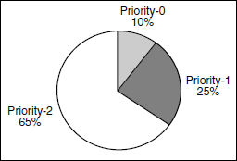

Slide 31
Methodology for selecting test cases
Once the test cases are classified into different priorities, the test cases can be selected.
There could be several right approaches to regression testing which need to be decided on “case to case” basis.
There are several methodologies available in the industry for selecting regression test cases.
Case 1 If the criticality and impact of the defect fixes are low, then it is enough that a test engineer selects a few test cases from test case database (TCDB) and executes them.

Slide 32
Case 2 If the criticality and the impact of the defect fixes are medium, then we need to execute all Priority-0 and Priority-1 test cases. If defect fixes need additional test cases (few) from Priority-2, then those test cases can also be selected and used for regression testing.
Case 3 If the criticality and impact of the defect fixes are high, then we need to execute all Priority-0, Priority-1 and a carefully selected subset of Priority-2 test cases

Slide 33
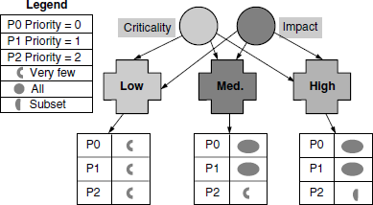
The cases discussed above are illustrated in Figure:

Slide 34
The above methodology requires that the impact of defect fixes be analyzed for all defects. This can be a time-consuming procedure.
If, for some reason, there is not enough time and the risk of not doing an impact analysis is low, then the alternative methodologies given below can be considered.
Regress all For regression testing, all priority 0, 1, and 2 test cases are rerun. This means all the test cases in the regression test bed/suite are executed.
Priority based regression For regression testing based on this priority, all priority 0, 1, and 2 test cases are run in order, based on the availability of time. Deciding when to stop the regression testing is based on the availability of time.

Slide 35
Regress changes For regression testing using this methodology code changes are compared to the last cycle of testing and test cases are selected based on their impact on the code
Random regression Random test cases are selected and executed for this regression methodology.
5. Context based dynamic regression A few Priority-0 test cases are selected, and based on the context created by the analysis of those test cases after the execution (and outcome, additional related cases are selected for continuing the regression testing.

Slide 36
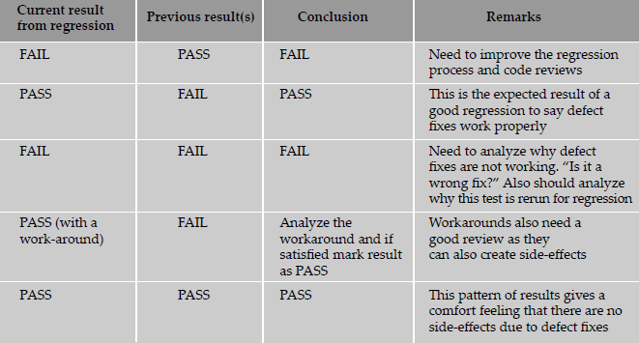
Conclude the results of a regression test cycle

Slide 37
Internationalization (I₁₈n) Testing
Primer
Language – Language is a tool used for communication
ASCII – American Standard Code for Information Interchange:
Uses 8 bit for representing characters
Basic ASCII uses 7 bits (128 chars) and extended ASCII uses 8 bits (256 chars)
European characters and punctuation symbols are easily represented in extended ASCII
It also includes accented chars (ñ, á, é, í, ó, ú )

Slide 38
Internationalization (I₁₈n) Testing
Locale
Each of the languages is spoken differently in different countries and states
There could be many countries speaking the same language, using the same characters, punctuations, etc.
But some conventions may be different (currency and date format)
For example, English is used widely in the US and India, but
Currency : $ and Rs.
$1,000,000 and Rs. 1,00,000
There could be multiple currencies in a country (Euro and Franc in France)
There could be multiple locale for a language in the same country

Slide 39
Internationalization (I₁₈n) Testing
Internationalization
also called I₁₈n
Represents all activities to make products available to the international market
Includes both DEV & testing activities
Localization
Also called L₁₀n
Translation of all product messages and documentation
Done by language experts
Includes both DEV & testing activities

Slide 40
Internationalization (I₁₈n) Testing
Globalization
Not very popular
Also called G₁₂n
Internationalization includes localization but some companies want to separate as the team that does both are different, and hence this term

Slide 41
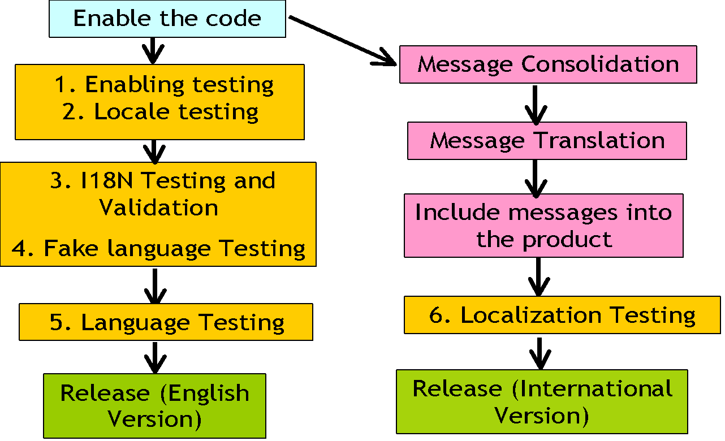
Test Phases

Slide 42
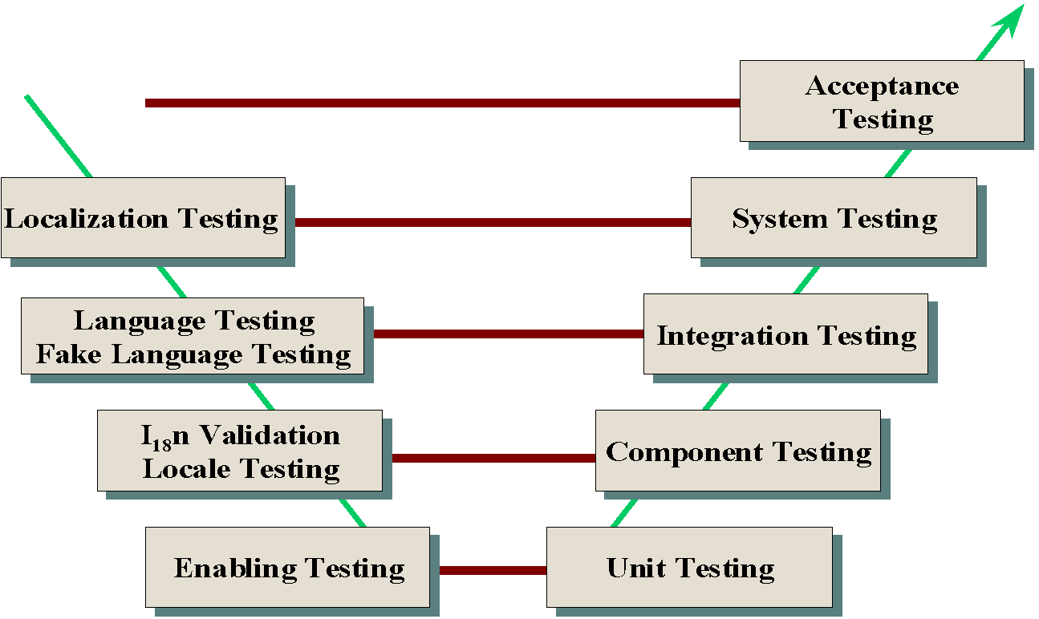
Test Phases

Slide 43
Enabling Testing
White box testing methodology
To ensure source code allows I18n
Codes with hardcoded strings, currency format, punctuations, date format, fixed GUI length are not considered enabled codes
An activity of code review mixed with test cases for unit testing to find I18n defects is called enabling testing
The year 2000 is a classic I18n defect
Enabling testing finds the majority of I18n defects

Slide 44
Enabling Testing - Checklist
Find out those APIs/function calls that can’t be used for I18n (printf, scanf) – NLSAPI, unicode, GNU gives some APIs instead
Check the code for hard-coded date, currency format, ASCII usage
Check the code for arithmetic operations on date
Check that no format is forced to date field
Check each field in the screen for extra space (normally 50% extra space is allotted)
Ensure that region-based messages/slang are not used (e.g., Hi, references to colour)

Slide 45
Enabling Testing - Checklist
Ensure no string operations are performed on the code (substring search, concatenation); only APIs provided by I18n are to be used
The code does not assume any predefined path, filename, directory name in NLS directory
Check code doesn’t make any assumptions about bit representation (8, 16, 32), and bit operations are not used
Ensure adequate length is allocated to accommodate translated messages
Check that pictures, logos and bitmaps do not have embedded text

Slide 46
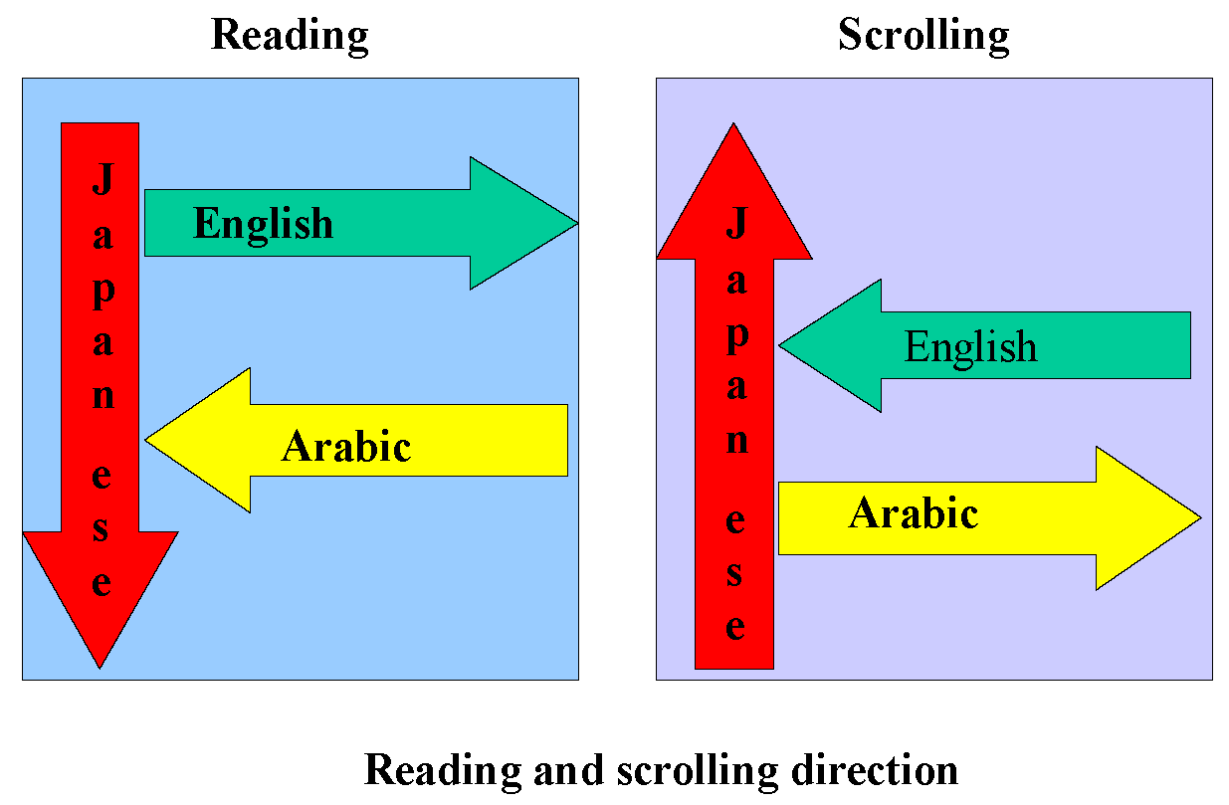
Enabling Testing

Slide 47
Locale Testing
Changing the different locale using the system settings or environment variables, and testing the software functionality, number, date, time and currency format is called locale testing.
It is to used validate the effects of locale change in the product. A locale change affects date, currency format, the display of items in the screen, dialog boxes and the text.
Black box methodology tests all component features for each locale.
In Microsoft Windows 2000, you can change locale by clicking “Start->Settings->Control Panel->Regional options (demo).

Slide 48
Locale Testing - Checklist
All features that are applicable to I18n are tested with different locales of the software for which it is intended.
Some of the activities that need not be considered for I18n testing are auditing, debug code, log of activities and such features that are used only by English administrators and programmers.
Hot keys, function keys and help screens are tested with different applicable locales (this is to check whether locale change would affect the keyboard settings).
Date and time format is in line with the defined locale of the language. For example if the US English locale is selected, the software should display data in mm/dd/yyyy date format.
Currency is in line with the selected locale and language. For example, currency should be AUS$ if the language is AUS English.

Slide 49
I18n Validation - Objectives
The software is tested for functionality with ASCII, DBCS, and European characters
The software handles string operations, sorting, sequencing operations as per the language and characters selected
The software display is consistent with characters that are non-ASCII in GUI and menus
The software messages are handled properly

Slide 50
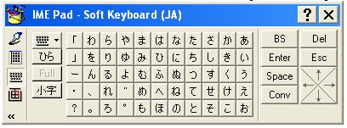
I18n Validation – Input Method Editor
This is a soft keyboard used to enter non-English characters into the product

Slide 51
I18n validation – Checklist
The functionality in all languages and locales are the same.
Sorting and sequencing the items are as per the conventions of language and locale. For example if $ is mentioned as the currency symbol for USA, sorting should take care of symbol & punctuations.
The input to the software can be in non-ASCII (Use of tools such as IME) and functionality is consistent with non-ASCII.
The non-ASCII characters in the name are displayed as they were entered.
The cut or copy -and-paste of non-ASCII characters retains their style after pasting, and the software functions as expected.

Slide 52
Fake Language Testing
Product
English
Hello!
Hello!
Ellohay
!
PigLatin
Hello
WideRoman
!

Slide 53
Fake Language Testing
Ensure the software functionality is tested for at least one of the European single byte fake languages (e.g., Pig Latin)
Ensure the software functionality is tested for at least one double byte language (e.g., Wide Roman)
Ensure all strings are displayed properly in the screen
Ensure the screen width, size of pop-ups and dialog boxes are adequate for string display with the fake languages

Slide 54
Language Testing
Short form of “language compatibility testing”
This testing is done to ensure that on other language settings the functionality of the software is not broken and that it is still compatible across the network.
When data is transmitted between machines or between software and operating systems, the code page, bit stream, message conversions taking place for internationalization

Slide 55
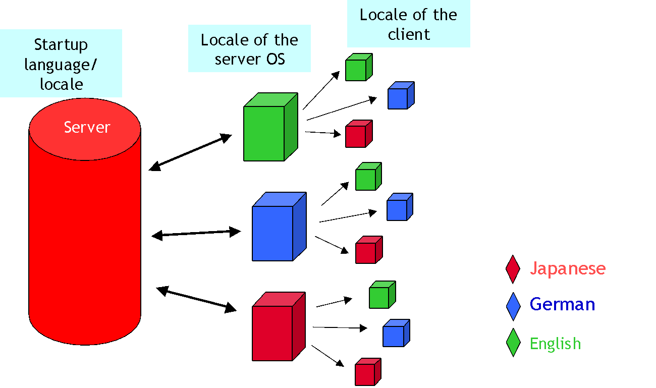
Language Testing

Slide 56
Localization Testing
Build tools consolidate all messages.
Documents and other artifacts are collected.
They are sent to language experts for translation.
Process of localization is expensive.
Not all messages, documents need to be localized.
Process of localization also alters the GUI screens, dialog boxes, icons and bitmaps.
Process of customization.
The product is installed in a specific language and tested by language experts.

Slide 57
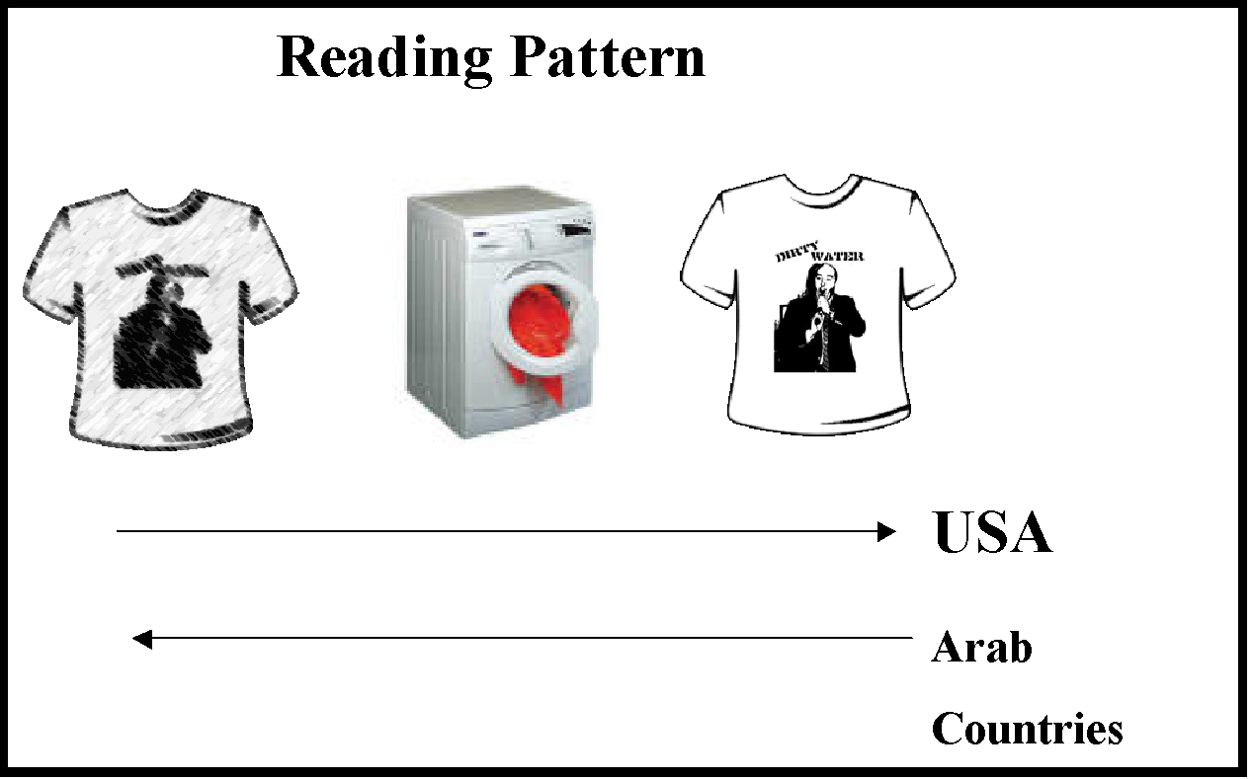
Localization Testing

Slide 58
Ad Hoc Testing
What does ad hoc mean?
Created and done for a particular purpose
To the purpose (origin: Latin)
Issues of planned testing
Goes by level of understanding at the time of design
Validation of test cases happens at runtime
Lack of clarity on requirements impacts quality
Lack of skills affects quality of test cases
Lack of time for design affects completeness

Slide 59
Definition: Ad Hoc Testing
Testing done without using any formal testing technique is called ad hoc testing.
Product gets tuned to test cases
It is not always possible to keep the test cases updated
Updating test cases considered tedious and time consuming
This is the place ad hoc testing plays its role

Slide 60
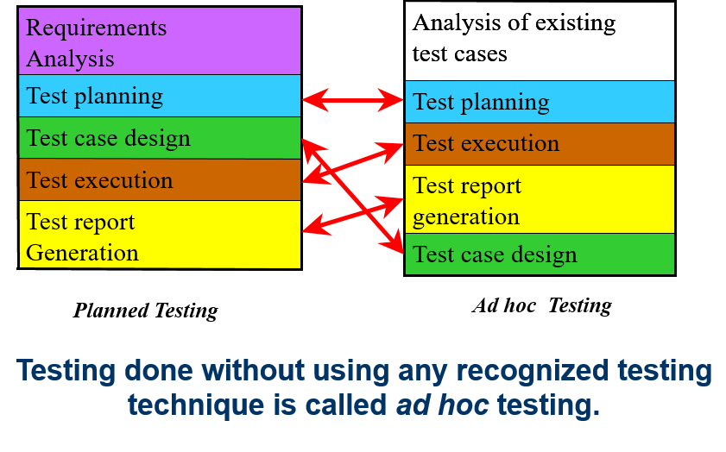
Ad hoc Testing vs Planned Testing

Slide 61
Ad hoc Testing - Advantages
Better understanding of product happens by testing – utilizes the value immediately.
Changes in requirements are not communicated immediately – leads to uncovered defects; Ad hoc testing helps to find them.
Ad hoc testing explores intuition and out-of-the-box thinking.
Ad hoc testing can be done in any testing phase and for any type of testing.
After planned testing – Newer defects can be found
Before – to validate test case completeness, product quality
Switch the context of usage to discover more defects – monkey testing.
Note : Ad hoc testing is not unplanned testing; it differs from planned testing in that test cases are not documented immediately.

Slide 62
Drawbacks
Drawback | Possible resolution
Difficult to ensure the perspectives covered in ad hoc testing are used in future | Document ad hoc tests after test completion
Large number of defects found in ad hoc testing | Schedule a meeting to discuss defect impacts Improve the test cases for planned testing
Lack of comfort on coverage of ad hoc testing | When producing test reports combine the planned test and ad hoc test Plan for additional planned test and ad hoc test cycles
Difficult to track the exact steps done | Write detailed defect reports in a step-by-step manner^{[1]} Document ad hoc tests after test execution
Lack of data for metrics analysis | Plan the metrics collection for both planned tests and ad hoc tests, not only for ad hoc testing

Slide 63
TESTING OF OBJECT ORIENTED SYSTEM

Slide 64
PRIMER ON OBJECT ORIENTED SYSTEM:
The goal is to highlight the measure concepts that cause some modifications and additions to the approach of testing that we have seen so far.
Fundamentally the procedure oriented programming language was categorized by
Data being considered as separate from the operations or program
Algorithm being the driver, with data being subsidiary to the algorithm

Slide 65
The properties of object oriented systems are:
Object
Classes
Encapsulation:
Inheritance:
Polymorphism:
Dynamic Binding:

Slide 66
Difference between procedure and object oriented programming
The paradigm shift from algorithmic centric, control based approach of procedure oriented programming to object centric, message based approach of object oriented programming changes the way the programs are to be written or tested.
The second difference, the message based approach brings in is that these messages can be passed to the instantiations only after instantiation is created. Messages passed to objects that are not instantiated can result in run time errors. Such errors are difficult to catch by the static testing methods.

Slide 67
TESTING IN OBJECT ORIENTED SYSTEM:
From a testing perspective the implication is that testing an object oriented system should tightly integrate data and algorithms.
Testing OOS broadly covers the following topics:
Unit testing a class
Putting classes to work together(integration testing of classes)
System testing
Regression testing
Tools for testing OO systems

Slide 68
Unit Testing A Set Of Classes:
As a class is built before it is published for use by others, it has to be tested to see if it is ready for use. Classes are the building blocks of entire OO system.
Why classes have to be tested individually first:
A class is intended for heavy reuse
Many defects gets introduced at the time a class gets defined.
A class may have different features, different clients of the class may pick up different pieces of the class
A class is a combination of data and methods
OO system has special features like polymorphism and inheritance.

Slide 69
Putting Classes To Work Together-Integration Testing:
The various methods of integration like top-down, bottom-up, big bang and so on are applicable. The important points to be noted of integration testing OO system are:
OO system are inherently meant to be built out of small, reusable components. Hence integration testing will be even more critical for OO systems.
There is typically more parallelism in the development of the underlying components of OO system, thus the need for frequent integration is higher.

Slide 70
System Testing and Interoperability of OO System:
Object oriented systems are by design meant to be built using smaller reusable components. This heavy emphasis on reuse of existing building blocks makes system testing even more important for OO systems than for traditional systems. The reasons for this are :
A class may have different parts, not all of which are used at the same time.
Different classes may be combined together by a client and this combination may lead to new defects that are hitherto uncovered.
An instantiated object may not free all its allocated resources, thus causing memory leaks and such related problems, which will show up only in the system testing phase.

Slide 71
Regression Testing of OO Systems
The heavy reliance of OO systems on reusable components, changes to any one component could have potentially unintended side-effects on the clients that use the component. Hence, frequent integration and regression runs become very essential for testing OO systems. It is also because of changes resulting from properties like inheritance, it is very important to catch the defects as early as possible.

Slide 72
Tools for Testing of OO Systems
There are several tools that aid in testing OO system. Some of these are :
Use cases
Class diagrams
Sequence diagrams
Activity diagrams
State charts

Slide 73
USABILITY AND ACCESSIBILITY TESTING
What Is Usability Testing?
Usability testing attempts to characterize the “look and feel” and usage aspects of a product, from the point of view of users.
Some of the factors that fuel the debate on usability are:
Usability and look-and –feel aspects are subjective in nature and cannot always be objectively measured.
Perceptions of “good usability” varies from user to user.
User interface can be constructed as a design time activity.
Something that is easy for one user may not be easy for another user due to different types of users a product can have.

Slide 74
Characteristic of usability testing are:
Usability testing tests the product from the users point of view.
Usability testing is for checking the product to see if it is easy to use for the various categories of users.
Usability testing is a processes to identify discrepancies between the user interface of the product and the human user requirements.

Slide 75
Approach To Usability
When doing usability testing, certain human factors can be represented in a quantifiable way and can be tested objectively.
The number of mouse clicks, number of submenus to navigate, number of keystrokes, number of commands to perform a task can all be measured and checked as part of usability testing.
Usability testing is not only for product binaries or executable. It also applies to documentation and other deliverables that are shipped along with a product.

Slide 76
Best Suited People To Perform Usability Testing:
Typically representative of the actual user segments who would be using the product, so that the typical user patterns can be captured.
People who are new to the product, so that they can start without any bias and be able to identify usability problems.
A part of the team performing usability testing is selected from representatives outside the testing team.

Slide 77
Means To Verify Usability Design
Style Sheets
Screen prototypes
Paper design
Layout design

Slide 78
How to Achieve Usability?
Involving the users proactively on user interface design can yield good results.
User interface requirements cannot be expressed in terms of words. One has to use the product to get a feel of its usability.
That is why involving the customers to give feedback on all the user interface requirements upfront.
This is not always possible because:
The user may not have the time or bandwidth to participate in this exercise.
There may be a number of users who may give conflicting requirements and it would not be possible to satisfy everyone.
In the case of breakthrough products, the users may not even be able to visualize the usage of the product.

Slide 79
Quality Factors For Usability:
The quality factors that help in improving objectivity in usability testing are :
Comprehensibility
Consistency
Navigation
Responsiveness

Slide 80
AESTHETICS TESTING
Another important aspect in usability is making the product “beautiful”. Performing aesthetics testing helps in improving usability further. All the aesthetic problems in the product are generally mapped to defect classification called “Cosmetic”, which is of low priority. Having a separate cycle of testing focusing on aesthetics helps in setting up expectations and also in focusing on improving the look and feel of the user interfaces

Slide 81
ACCESSIBILITY TESTING
“Verifying the product usability for physically challenged users is called accessibility testing”. There are a large number of people who are challenged with vision, hearing and mobility related problems- partial or complete.
Accessibility to the product can be provided by two means:
Making use of accessibility features provided by the underlying infrastructure, called basic accessibility.
Providing accessibility in the product through standards and guidelines, called product accessibility.

